Slide 1
Improving Blockchain Scalability: Sharding
Sajan Maharjan
20182095
CSED 601 Dependable Computing
19th Dec. 2018

Slide 2
Recap
Discussion of dependability issues in blockchain
1st Presentation-
Solving integrity issues in blockchain using LedgerGuard
2nd Presentation-
Scalability issues, transaction processing capability, scalability trilemma
Proposed solutions- sharding, offchain solutions, consensus protocols, etc.
Final Presentation-
Details on Sharding

Slide 3
Introduction
Sharding- partitioning of network into smaller committees, each of which processes a disjoint set of transactions (or “shards”)
ELASTICO – first secure candidate for a sharding protocol to open blockchain that tolerate byzantine adversaries
Elastico and Ziliqa make use of Proof of Work and Byzantine consensus algorithms
Achieves linear transaction throughput with increase in the computational power of the network

Slide 4
Assumptions
Given n miners in the network, can tolerate upto f <= n/4 byzantine adversaries.
Honest nodes are reliable during protocol runs and failed or disconnected nodes are counted as byzantine nodes.
Entire network of size n is divided into smaller shards or committee each of size at least c nodes
Each shard outputs a separate set of transactions
Partially synchronous network- any broadcasted message will reach a node within a bounded delay of δt seconds

Slide 5
Design
Parallelization is achieved by dividing total computational power into smaller shards and Directory Service committee, each processing a disjoint set of transactions
Each DS committee or shard of size c, runs byzantine consensus protocol to agree on a set of transactions
Each DS committee or shard has its own leader
DS committee is responsible for combining the transaction blocks selected from each shard
Algorithms proceed in epochs or rounds

Slide 6
Design (contd…)
Each epoch involves the following steps
Identity Establishment and Committee Formation
Shard Assignments
Sharding Logic Publishing
Transaction Sharding and Building Micro-Block Consensus
Final Block Proposal and Consensus
Block Confirmation and Epoch Randomness Generation

Slide 7
Design (contd…)
Step 1: Identity Establishment and Committee Formation
Pseudonymous identity using public key and IP address
Two group of nodes/miners- DS nodes and regular nodes
Miners find a PoW solutions corresponding to their identity to join mining
H(epochRandomness || IP || PK || nonce) <= 2^{γ-D}
γ is the length of hash output
D is the no. of leading zeros
PoW prevents sybil nodes
Epoch randomness prevents byzantine adversary from precomputing the hash value output before a specified time or epoch

Slide 8
Design (contd…)
Step 1: Identity Establishment and Committee Formation (contd…)
Election of directory service nodes takes place first
DS Committee has a fixed number of nodes and the first N_{O} nodes to solve the PoW are selected into DS Committee
A leader is elected from one of the members of DS Committee and new leader/committee members are added in each epoch
Previous epoch randomness value is used for valid PoW solutions

Slide 9
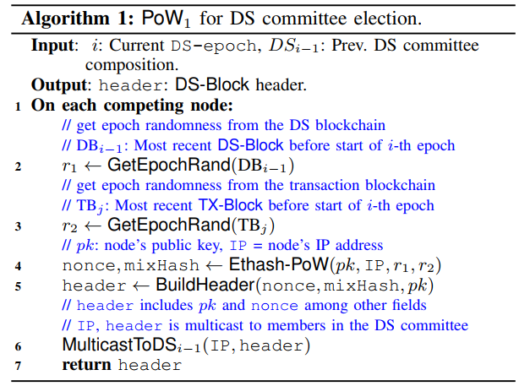
Design (contd…)
Step 1: Identity Establishment and Committee Formation (contd…)
Fig 1. Algorithm for DS committee election

Slide 10
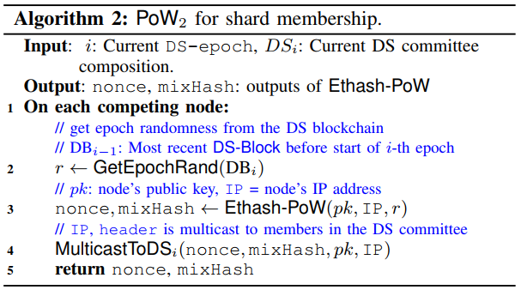
Design (contd…)
Step 1: Identity Establishment and Committee Formation (contd…)
Completion of DS Committee elections -> Regular Nodes/Miner nodes elected
Fig 2. Algorithm for shard member election

Slide 11
Design (contd…)
Step 2: Shard Assignment
Nodes that solve PoW solutions are assigned to different shards numbers-
Compare nonce values of PoW solutions and assign them to shard number on increasing order
If there are 2^{s} different shards, use last s-bits of H to assign to different shard
H is random -> last s-bits of H is random -> assignment of a node to a particular shard is also random -> each shard will have no more than 1/3 of malicious nodes
One of the nodes in each shard is assigned leader (Compare nonce values?)

Slide 12
Design (contd…)
Step 3: Shard Logic Publishing
DS Nodes publish information on public channel
Identities and connection information of DS Nodes
List of selected nodes in each shard
Sharding Logic for Transaction
Which shard will store a specific transaction?
For a given transaction from A to B, and assuming there are 2^{s} different shards, use the rightmost s-bits of the sender address to determine which shard stores the transaction
Double spending can be prevented by checking nonce value of transaction against nonce value in the account states

Slide 13
Design (contd…)
Step 4: Transaction Sharding and Building Micro-Block Consensus
As explained earlier, which shard stores which transaction is determined
Transactions are collected by nodes in a shard and sent to shard leader
Transactions are grouped into a block called MicroBlock by leader
Consensus for validity of each transaction and MicroBlock -> requires 2/3 of signatures of nodes in the block
Upon success, MicroBlock headers (containing txn hash) and Bitmap (signifies multi-signatures) sent to few DS Nodes by leader

Slide 14
Design (contd…)
Step 5: Final Block Proposal and Consensus
DS Nodes collect MicroBlock headers and sends to DS Committee leader
Leader validates MicroBlock and combines them to generate Final Block header and proceeds to consensus
Consensus requires 2/3 of signatures approval from DS nodes
Leader builds Bitmap and Final Block header and sends it to nodes in each shard

Slide 15
Design (contd…)
Step 6: Block Confirmation and Epoch Generation
Nodes in each shard confirm the signature in Bitmap against DS Nodes in the public channel
Final Block header containing transaction hash compared against Micro-block header transaction hash
If match -> transaction data is appended to the final block in the local shard
Account States & Global States are updated
At the end of each epoch some random value is generated to prevent malicious nodes from pre-computing hash values

Slide 16
Leader Change
Byzantine leader can intentionally drop or delay messages from honest nodes
Periodically change leader of each shard and DS committee
Leader of each shard is changed after every micro block
Leader of the DS Committee is changed after every final block
If size of DS consensus group is n, then epoch lasts for generation of n final blocks with leader change after every final block
Each final block consists of 1 micro-block from each shard

Slide 17
Cross-Shard Transactions
No need to communicate with another shard if both sender and receiver in same shard
Alice (address in Shard #1) wants to send tokens to Bob (address in Shard #2)
Requires updating state in both Shard #1 and Shard #2
Two Approaches
Synchronous
State Transition information related to both addresses produced at the same time
Asynchronous
“Credit” shard executed after “Debit” shard has completed execution
Validity of transactions questionable in the case of forks

Slide 18
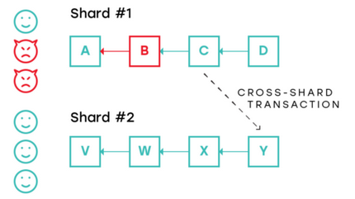
Cross-Shard Transactions (contd…)
Requires the assumption of less than 1/3 malicious nodes in each shard to prevent forking
Say (by a negligible probability), malicious nodes collude on a shard
Image Courtesy: Medium

Slide 19
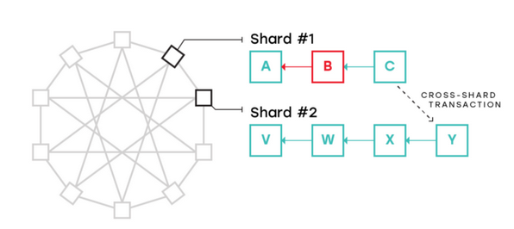
Cross-Shard Transactions (contd…)
Undirected Graph can be used that shares the cross-shard transaction history
Shard #2 invalidates block B from Shard #1
Image Courtesy: Medium

Slide 20
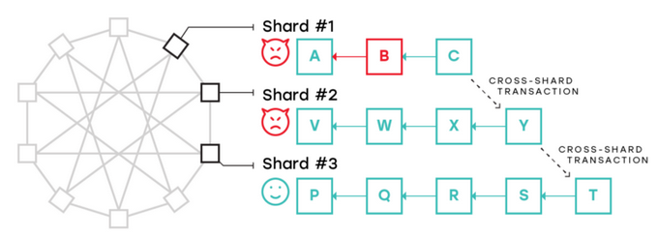
Cross-Shard Transactions (contd…)
Say (very very negligible probability) two or more shards are colluded
Malicious block B is obfuscated
Image Courtesy: Medium

Slide 21
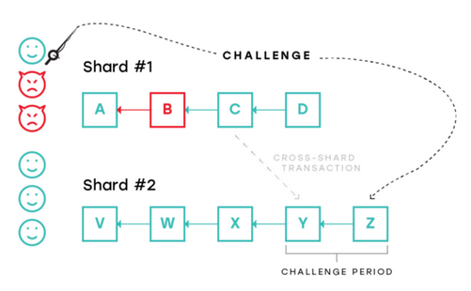
Cross-Shard Transactions (contd…)
Fisherman Approach
Honest validators issues a challenge that a certain block is invalid, for a given period of time
Shard is secure even with just one honest node in the shard
Cryptographic Proof of Computation
Image Courtesy: Medium

Slide 22
Scalability Achievement
Transaction data is not transmitted, only micro block header and final block header containing transaction hash is transmitted
Use of EC-Schnorr signature algorithm achieves speed and requires less size for multi-signatures
Elastico shows that the throughput scales up linearly in the computation capacity of the network
Ziliqa believes achieving 1000X scalability of Ethereum given a network size of Ethereum

Slide 23
References Used
The Ziliqa Technical Whitepaper, https://docs.zilliqa.com/whitepaper.pdf
CCS 2016 - A Secure Sharding Protocol For Open Blockchains, https://www.youtube.com/watch?v=AlPMYyGVkRk
A Secure Sharding Protocol For Open Blockchains, http://delivery.acm.org/10.1145/2980000/2978389/p17-luu.pdf?ip=141.223.124.8&id=2978389&acc=ACTIVE%20SERVICE&key=0EC22F8658578FE1%2E25E83D88E716D18F%2E4D4702B0C3E38B35%2E4D4702B0C3E38B35&__acm__=1544631713_e0a9cf3b64b146e76b8dd6a126a46c01
Unsolved Problems in Blockchain Sharding, https://medium.com/nearprotocol/unsolved-problems-in-blockchain-sharding-2327d6517f43
The Authoritative Guide to Blockchain Sharding, Part 1, https://medium.com/nearprotocol/the-authoritative-guide-to-blockchain-sharding-part-1-1b53ed31e060

